Slide 1

XPATHS and Different Waits in Selenium Web driver
Abhijeet Pathak
|SDET | BFG|
Email: abhijeet.b.pathak@accenture.com

Slide 2
Let's explore XPATHS:
What is XPATH?
XPath in Selenium is a query language that can be used to search and locate web elements in HTML documents.
In Selenium automation, if the elements are not found by the general locators like id, class, name, etc. then XPath is used to find an element on the web page.
XPath follows an XML path to navigate through the HTML structure of a web page.
Below is the Syntax of xpath:
Syntax: //tagname[@Attribute =’Value’]
Example: //div[@class =”firstname”]

Slide 3
Types of Xpath:
There are two types of XPath in Selenium.
Absolute XPath
Relative Xpath
And we have- Xpaths for Dynamic Elements

Slide 4
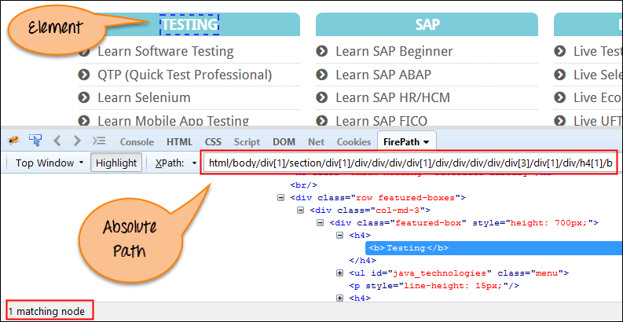
Absolute XPATH
Absolute XPath: Absolute Xpath is the simplest form of XPath in Selenium. It starts with a single slash ‘/’ and provides the absolute path of an element in the entire DOM.
Syntax: html/body/div[1]/header/div/div[1]/div[3]/div/form/div[3]/div[1]/input.

Slide 5
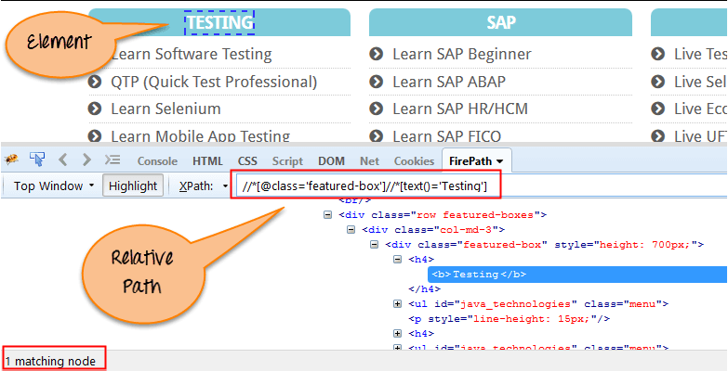
Relative XPATH
Relative XPath: In the case of relative XPath in Selenium, the XPath expression starts from anywhere in the DOM structure. It is represented by a double slash ‘//’ denoting the current node.
Syntax: //div[@class='featured-box -column size']//h4[1]//b[1]

Slide 6
Xpaths for Dynamic Elements
Dynamic elements are the elements for which value is changing and we are not able to use single attribute to locate the web element. In this case we have bunch of methods or combination of operators etc. to write Xpath.
Using ‘and’ Operator
Using ‘or’ Operator
Using ‘contains’
Using text()
Using Starts-with
Xpath Axes methods

Slide 7
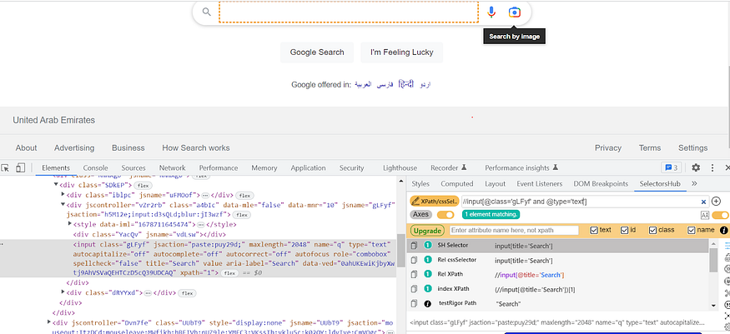
Using ‘AND’ operator
In this case we will be using more than one attribute to locate a web element.
Here both expressions needs to satisfy the condition.
Syntax: //tagname[@att1=’value1’ and @att2=’value2’]
For eg. //div[@id=”f_name” and @name=”firstname”]

Slide 8
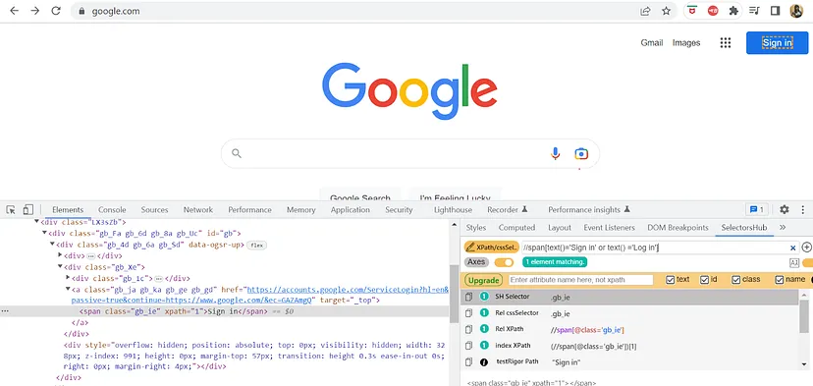
Using ‘OR’ operator
In this case we will be using more than one attribute to locate the webelement using ‘or’ operator. We use this in the cases where element locator values can change.
For eg. for Login, sometimes word ‘Sign In’ can also be used as an alternative to ‘Login’.
Syntax: //tagname[@att1=’value1’ or @att2 =’value2’]

Slide 9
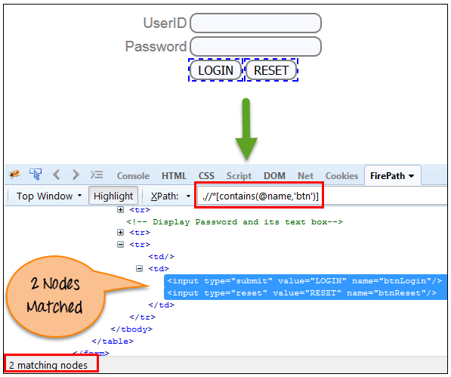
Using ‘contains’
This is very useful when user do not want to use the complete value of the attribute, or attribute value is not always fixed.
Syntax: //tagname[contains(@att, ’value’)]
For ex. //tagname[contains(text(), ’value’)]

Slide 10
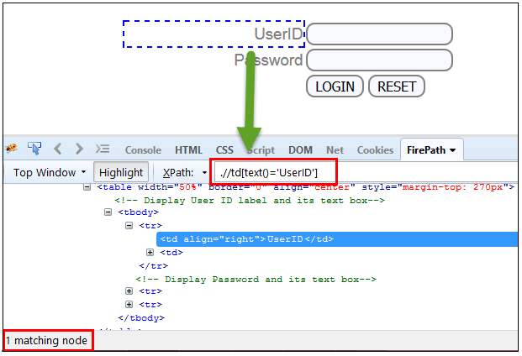
Using ‘text()’
The XPath text() function is a built-in function of selenium webdriver which is used to locate elements based on text of a web element.
It helps to find the exact text elements
Syntax: //tagname[text(), ’value’)]
For ex. Xpath=//td[text()='UserID’]

Slide 11
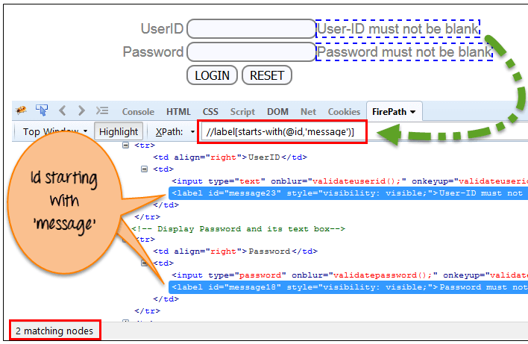
Using ‘starts-with()’
XPath starts-with() is a function used for finding the web element whose attribute value gets changed on refresh or by other dynamic operations on the webpage
In this method, the starting text of the attribute is matched to find the element whose attribute value changes dynamically
  For ex. Suppose the ID of particular element changes dynamically like
  Id=” message12″
  Id=” message345″
  Syntax : //label[startswith(@id,'message’)]

Slide 12
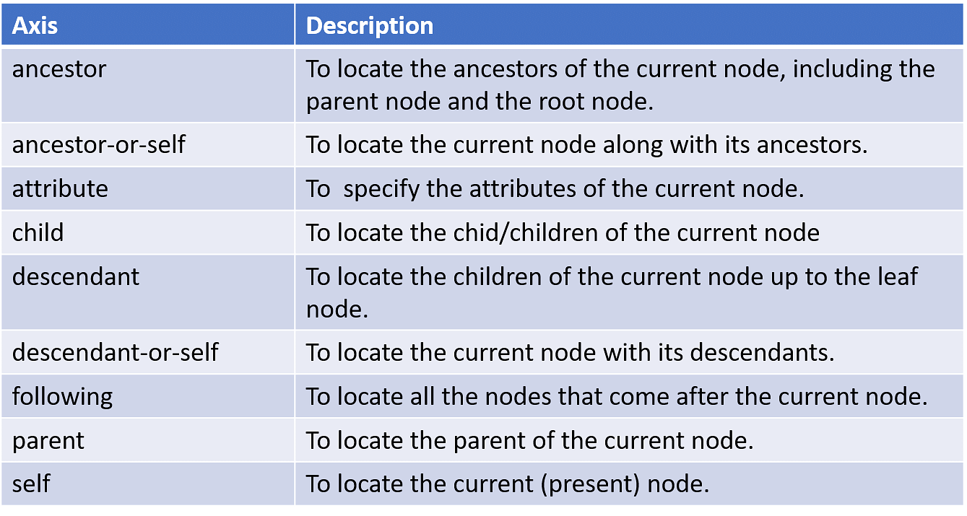
What are xpath axes?
All the XML DOM elements are in a hierarchical structure and can be either located using Absolute paths or Relative paths. For this, XPath provides specific attributes called "XPath Axis.“
Here, An axis represents a relationship to the context (current) node and is used to locate nodes relative to that node on the tree. So, the XPath Axis uses the relation between several nodes to find those nodes in the DOM structure.

Slide 13
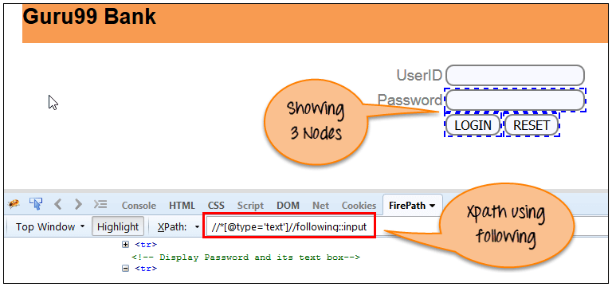
Following
Selects all elements in the document of the current node( ).
(UserID input box is the current node) as shown in the image.
Syntax://*[@type='text']//following::input
There are 3 “input” nodes matching by using “following” axis- password, login and reset button.
//*[@type='text']//following::input[1]

Slide 14
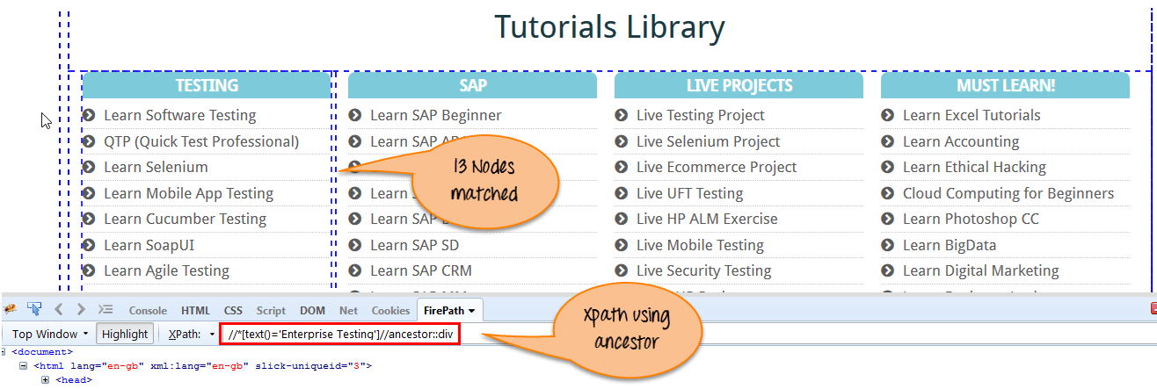
Ancestor
The ancestor axis selects all ancestors element (grandparent, parent, etc.) of the current node.
In the below image, we are finding ancestors element of the current node(“ENTERPRISE TESTING” node).
Syntax://*[@type='text']// ancestor::div
There are 13 “div” nodes matching by using “Ancestor” axis- if you want to focus on element use index as shown below.
//*[text()='Enterprise Testing']//ancestor::div[1]

Slide 15
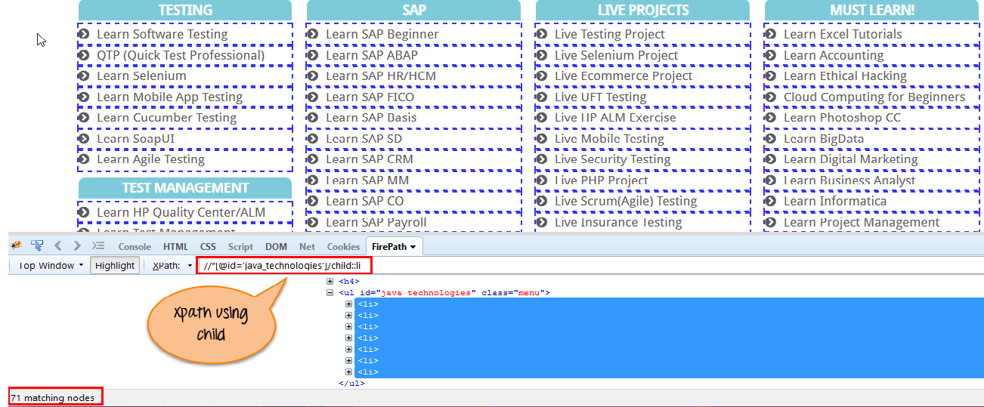
Child
The child axis selects all children elements of the current node.
Syntax: //*[@id='java_technologies']//child::li
There are 71 “li” nodes matching by using “child” axis-if you want to focus on element use index as shown below.
//*[@id='java_technologies']//child::li[1]

Slide 16
Other xpath axes
Preceding: Select all nodes that come before the current node.
Xpath=//*[@type='submit']//preceding::input
Following-sibling: Select the following siblings of the context node. Siblings are at the same level of the current node.
xpath=//*[@type='submit']//following-sibling::input
3. Parent: Selects the parent of the current node.
Xpath=//*[@id='rt-feature']//parent::div
Self: Selects the current node or ‘self’ means it indicates the node itself
Xpath =//*[@type='password']//self::input
Descendant: Selects the descendants of the current node
Xpath=//*[@id='rt-feature']//descendant::a

Slide 17
Waits in selenium webdriver
What are wait commands and why do we need waits?
Different Types of waits.

Slide 18
What are wait commands and why do we need waits?
When a web page loads on a browser, various web elements (buttons, links, images) that someone wants to interact with may load at various intervals.
The wait commands are essential when it comes to executing Selenium tests.
It is common for testers to get the message “Element Not Visible Exception“. This appears when a particular web element with which WebDriver has to interact, is delayed in its loading. To prevent this Exception, Selenium Wait Commands must be used.
Selenium WebDriver provides three commands to implement waits in test, they are- Implicit wait, Explicit wait and Fluent wait.

Slide 19
Implicit wait
Implicit Wait directs the WebDriver to wait for a certain measure of time before throwing an exception. Once this time is set, WebDriver will wait for the element before the exception occurs.
To add implicit waits in test scripts, import the following package.
import java.util.concurrent.TimeUnit;
Syntax: driver.manage().timeouts().implicitlyWait(10, TimeUnit.SECONDS);
However, implicit wait increases test script execution time. It makes each command wait for the defined time before resuming test execution. If the application responds normally, the implicit wait can slow down the execution of test scripts.

Slide 20
Explicit wait
For Explicit Wait command, the WebDriver is directed to wait until a certain condition occurs before proceeding with executing the code.
To add explicit waits in test scripts, import the following package.
import org.openqa.selenium.support.ui.ExpectedConditions
import org.openqa.selenium.support.ui.WebDriverWait
Syntax: WebDriverWait wait = new WebDriverWait(driver,10);
wait.until(ExpectedConditions.visibilityOfElementLocated(By.xpath("//div[contains(text(),’TEST')]")));
Setting Explicit Wait is important in cases where there are certain elements that naturally take more time to load.
In order to declare explicit wait, one has to use ExpectedConditions.
E.g. presenceOfElementLocated(), visibilityOfElementLocated(), elementToBeClickable()

Slide 21
Fluent wait
Fluent Wait in Selenium marks the maximum amount of time for Selenium WebDriver to wait for a certain condition (web element) becomes visible. It also defines how frequently WebDriver will check if the condition appears before throwing the “ElementNotVisibleException”.
Fluent Wait looks for a web element repeatedly at regular intervals until timeout happens or until the object is found.
Syntax:
  Wait wait = new FluentWait(WebDriver referene). withTimeout(timeout,SECONDS).pollingEvery(timeout,SECONDS).ignoring(Exception.class);
  WebElement foo = wait.until(new Function<WebDriver, WebElement>() {
  public WebElement apply(WebDriver driver) {
  return driver.findElement(By.id("foo"));}});
While using Fluent Wait, it is possible to set a default polling period as needed. The user can configure the wait to ignore any exceptions during the polling period

Slide 22
Thank you!

